Slide 1
Seeing
Waste

Slide 2
Value
Waste
Causes of Waste
Notes:
What is OpenAgile?
How does OpenAgile work?
Why should your organization use OpenAgile?

Slide 3
Defining Value
?
Notes:
What activities in a process actually add value to the end result?
All other activities are wasteful.

Slide 4
Customer Value Added
$
Notes:
CVA (or just VA for Value Added): adding form, fit or function to a product or service, an activity that the customer would be willing to pay for in isolation if they knew it was being done.

Slide 5
Business Value Added
√
Notes:
BVA (non-negotiable waste): an activity that is required to operate the business but the customer is unwilling to pay for as an independent product or service.

Slide 6
Non-Value Added
X
Notes:
NVA (pure waste): an activity that is not required by the business nor is the customer willing to pay for.
NOTE: finding NVA activities is hard because often existing activities are only needed because of how the work is being done. Changing the way work is done will produce the same results, but eliminate the need for the activity.

Slide 7
Example: Software
CVA: Creating code
BVA: Budget tracking
NVA: Waiting for a new hire with skills needed for the work

Slide 8
Example: Manufacturing
CVA: Converting raw materials to finished product
BVA: Workplace safety
NVA: Moving materials from spot to spot

Slide 9
Example: Cooking a Meal
CVA: Mixing ingredients
BVA: Cleaning the grill
NVA: Looking up a recipe

Slide 10
Discussion
Come up with your own examples of:
Customer Value Added $
Business Value Added √
Non-Value Added X

Slide 11
Types of Waste
X
Manufacturing:
Inventory
Extra processing
Overproduction
Transportation
Waiting
Motion
Defects
Software Development
Partially done work
Extra processes
Extra features
Task switching
Waiting
Motion
Defects

Slide 12
Causes of Waste
“Five Whys”
Analysis
Notes:
For each identified obstacle or example of waste, ask “why” it exists.
Ask “why” five times to get to the root cause of waste.

Slide 13
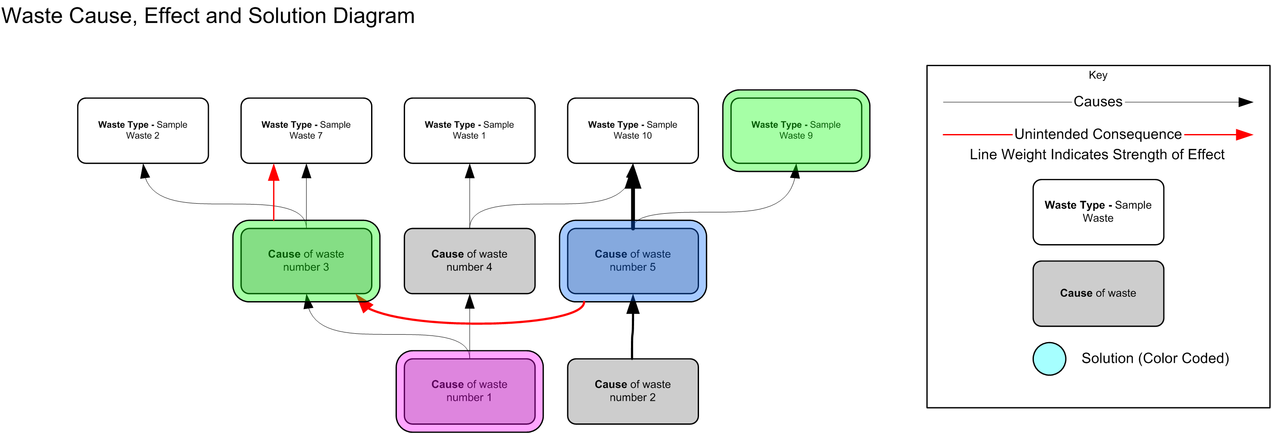
Root Cause Diagram

Slide 14
What is the relationship between waste and morale?

Slide 15
O
Notes:
Any questions or comments?

